Slide 1
Beer Consumption Prediction using ML
Presented By,
Kavan Shah (C0814185)
Kuntal Shah (C0797800)
Shweta Limbachiya (C0819165)
Professor:
Graham Wall

Slide 2
What is Machine Learning Model?
A machine learning model intends to determine the optimal structure in a dataset to achieve an assigned task.
It results from learning algorithms and applied on a training dataset.
Data + algorithms = model
The machine learning model is the data combined with the algorithms that is we are applying algorithms on the data to learn the model and it results in automated systems.

Slide 3
Steps to build a machine learning model
There are many ways to build a machine learning model; however, each implementations include the following steps in the solution pipeline:
Data Preparation
Feature Engineering
Data Modelling
Performance Measure
This is highly iterative process because after completion of these four steps, the final one is “Performance Improvement”, and It again takes us into the afore-mentioned steps.

Slide 4
What idea you will get from this presentation
How can you import your raw data?
What are methods for data cleaning?
How to convert raw data to relevant data for machine leaning model?
What are the various types of machine learning algorithms?
Which one should you choose to build model?
What is method to evaluate the performance of the model?

Slide 5
Dataset we have used
Beer is one of the most consumed drinks in the world. Around the world, thousands of people consuming drink regularly and in different situation.
Czech republic is the country that is the most consuming beer in the world. In 2015, the Czechs drank 142.4 litres per person.
The data is collected in Sao Paulo-Brazil for the year 2015. The dataset has 7 attributes listed below.
Date: The date, of the year 2015 which is daily date tracking.
Temp Median: Median temperature for the day.
Temp Min: Min temperature for that day.
Temp Max: Max temperature for that day.
Precipitation: Chance of rain for that day.
Weekend: Bool, 1: Weekend, 0: Weekday.
Consumption Litres: The amount of beer consumed for that day.

Slide 6
Libraries we have used for coding
Pandas
It is reference module to efficiently manipulate millions of rows of data in python.
Scikit learn
It is reference module for machine learning that features various classification, regression and clustering algorithms.
Matplotlib, Seaborn
These modules are more convenient for data visualization for making machine learning models.

Slide 7
Data Preparation
The data preparation can be done in 3 steps:
Querying data
As we have a csv file downloaded from Kaggle, we have used pandas for querying the dataset and get the “dataframe” which is the format that enables us to work on large volume of data.
Clean Data
This includes dealing with missing values and removing outliers from the dataset. We are removing the 576 null values presented in our dataset.

Slide 8
Data Preparation (Contd…)
Format your data
This step consists of modifying data such as converting some datatypes, encoding of categorical variables.
In our dataset, some numbers have commas instead of period (.). So that, first, we have replaced the commas with periods.
Second, we have converted some features’ datatypes to float to use them for leaning the model.
Here, the data preparation is completed and we’re ready to move on next step of solution pipeline which is “Feature Engineering”.

Slide 9
Feature Engineering
The feature is a measurable property of a phenomenon being observed.
The number of features (columns) that are used for leaning the model is known as dimension.
We have used 7 features (columns) so that we can say that we have used 7 dimensions in our model.
Feature engineering is a process of transforming raw data into relevant features resulting in improved model performance.

Slide 10
Feature Engineering (Contd…)
Relevant features are:
Informative – It gives useful data for the model to correctly predict the label
Discriminative – It helps model to make differences among training examples
Non-redundant – It differentiate the features

Slide 11
Feature Engineering (Contd…)
After feature engineering, the dataset becomes a big matrix of numerical values.
Further, feature engineering includes:
Feature Construction
Feature Transformation
Dimension Reduction

Slide 12
Feature Engineering (Contd…)
Feature Construction:
It means turning raw data into informative features that best represent the underlying problem.
This is where the domain expertise is needed, and this is the key to increase the performance of the model.
In our project, we have constructed features like days, months, season from the given date and temperature columns.

Slide 13
Feature Engineering (Contd…)
Feature Transformation:
It is the process of transforming the feature into new one by using any specific function such as scaling, log etc.
Dimension Reduction:
It is the process of reducing the number of features by keeping only informative, discriminative, non-redundant features.
In our dataset, the “weekend” is the feature which has no impact on the prediction. So that to get rid of dimensionality curse, we have removed it.

Slide 14
Benefits of Feature Engineering
Faster computation
Less storage space required
Increased model performance
Data visualization
Overall, Feature Engineering is the significant part to build efficient machine learning model.
Now, the dataset is ready to go, and machine can start the learning process.

Slide 15
Data Modelling
This is the process where we decide which learning method to use to train the model (supervised or unsupervised).
Supervised Learning:
It is used when training set has labels for output/target.
Unsupervised learning:
It is used when training set doesn’t contain label for target having only features.
We have selected supervised learning as we have “Consumption Litres” as the target column (feature).

Slide 16
Data Modelling (Contd…)
After selection of the supervised leaning, the next thing is to choose model.
Supervised learning is used to build two kinds of models listed below:
Regression – The label to predict having continuous value
Classification – The label to predict has discrete value
As in our dataset, the “Consumption Litres” column has continuous value, we are selecting regression model to perform.

Slide 17
Data Modelling (Contd…)
Choosing Best Algorithm:
In any machine learning problem, there is no such thing like “best algorithm” because of which choosing right algorithm is tricky and difficult in the machine learning.
It is irrefutable fact that various regression algorithms perform differently on various datasets. One can be worst for a dataset but the same can be the best for the other one.
This is the reason why we chose to work with various algorithms to find the best fit for our dataset.

Slide 18
Performance Measure
To assess the performance of model includes 2 steps:
First, use the model to predict the target column (feature).
Second, use some methods compare the predicted values with the real values that how much variation arrived in the prediction.

Slide 19
Performance Measure (Contd…)
To start predicting the label, we need to split the dataset into two parts that is train and test.
For this project, we have decided to split the dataset into 80-20 that is 80% for training purpose and 20% for testing.
The next thing is to select the correct performance indicator.

Slide 20
Performance Measure (Contd…)
Regression model performance indicators:
The commonly used performance indicators for regression are listed below:
Mean Squared Error (MSE)
Mean Absolute Error (MAE)
Coefficient of determination
Here, in our model, we have selected MAE as a performance indicator.
This is all that we need to implement in order to make a machine learning model. After this all we need is to improve the performance of the model if it is underfitted or overfitted.

Slide 21
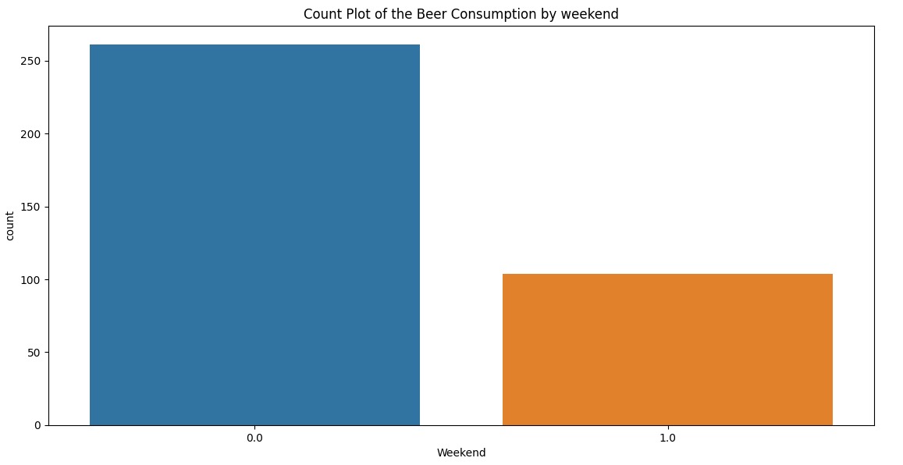
Dataset Visualization
Beer consumption is higher in weekdays instead of weekends

Slide 22
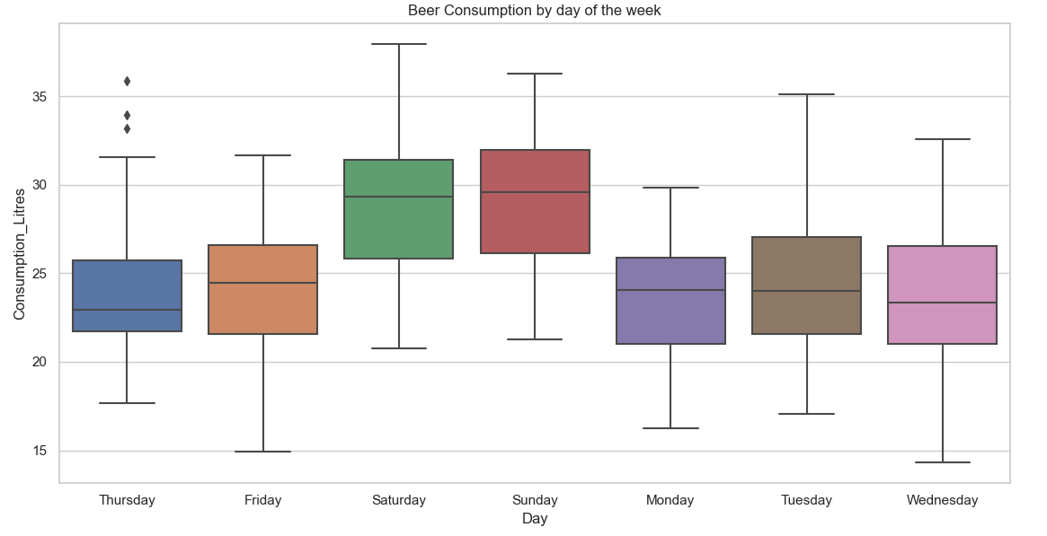
Dataset Visualization (Contd…)
Most of the beer is consumed on Saturdays and Sundays, so the
Beer is consumed during the weekends.

Slide 23
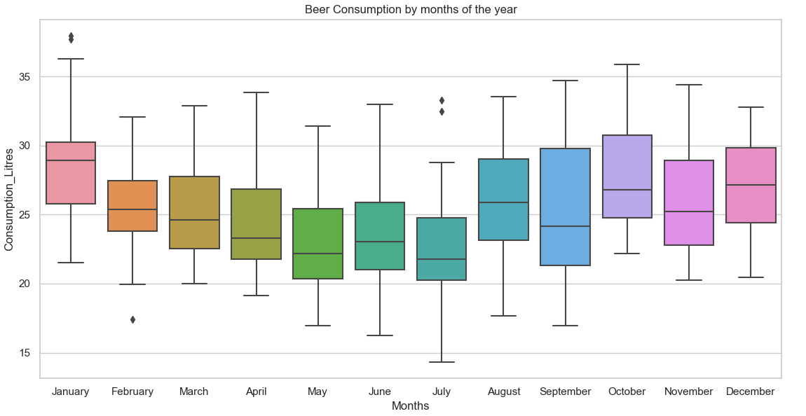
Dataset Visualization (Contd…)
Beer consumption is higher in the end of the year from December
to March. It is decreasing in the middle of the year.

Slide 24
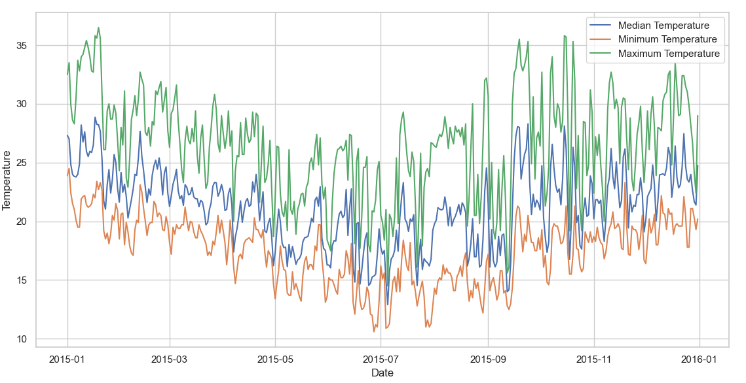
Dataset Visualization (Contd…)
Summer Months:
December to March
Autumn Months:
April, May
Winter Months:
June to September
Spring Months:
October, November
From the temperature variation, we can see that the seasons are
are changed.

Slide 25
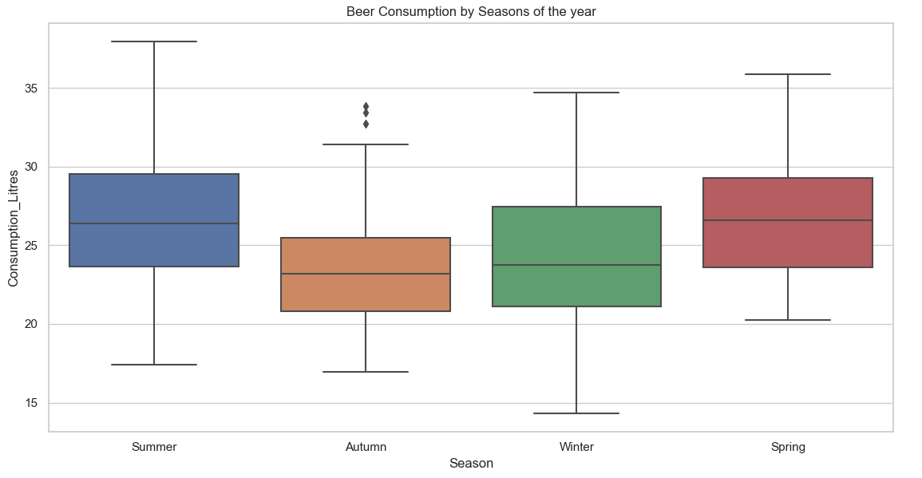
Dataset Visualization (Contd…)
Beer consumption is higher in Summer and Spring. In winter, the
beer is the least consumed.

Slide 26
Algorithms we have used for our dataset
Linear Regression
Random Forest
Gradient Boosting
Decision Tree

Slide 27
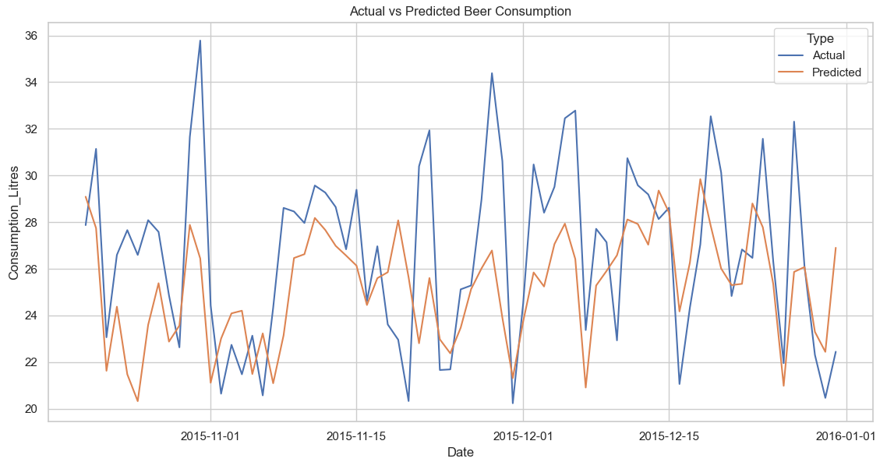
Prediction using Linear Regression
MAE = 2.849

Slide 28
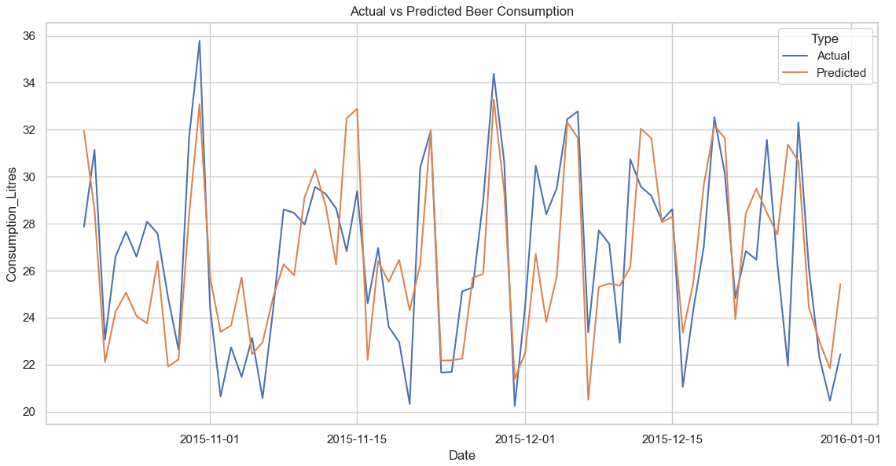
Prediction using Random Forest Regressor
MAE = 2.183

Slide 29
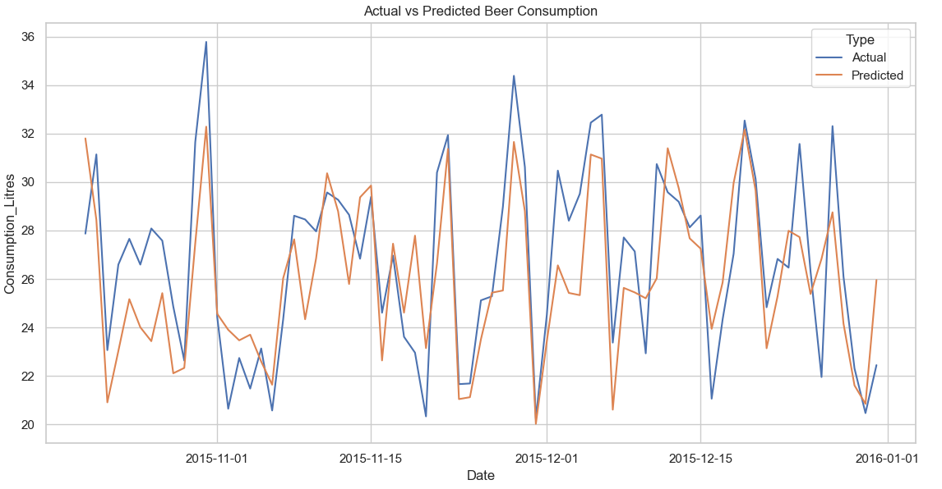
Prediction using Gradient Boosting Regressor
MAE = 2.057

Slide 30
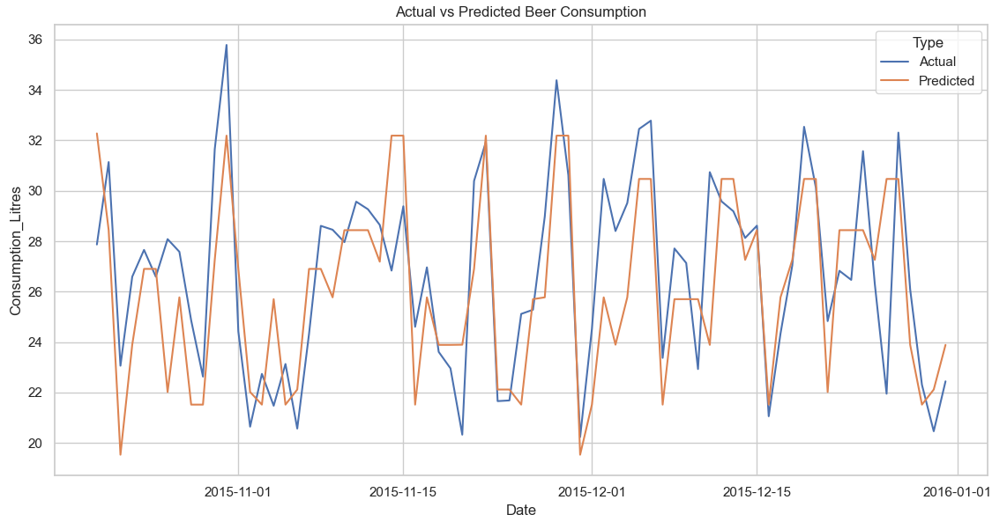
Prediction using Decision Tree Regressor
MAE = 2.209

Slide 31
Performance Measure
Mean Absolute Errors of models listed below:
Linear Regressor = 2.849
Random Forest Regressor = 2.183
Gradient Boosting Regressor = 2.057
Decision Tree Regressor = 2.209
Gradient boosting regressor is having the least error followed by random forest regressor and then there is decision tree regressor. The linear regressor has the highest error for the dataset.
So, the Gradient Boosting Regressor is the best model for the dataset and Linear regressor is the worst model.

Slide 32






Thank You!!

